Slide 1

B.Tech
BCSE497J – Project-I
Intelligent Investigative Interview Assistant Using Speech Emotion Analysis, Computer Vision and Large Language Models
Team members:
Ajmal Sadhiq (23BCE2201)
Garvit Kohli (23BCE2216)
Aniket Agrawal (23BCE2221)
Faculty guide :
Dr.Sivaprakash S

Slide 2

Approval Mail From Guide
Get the approval for the following points from your guide through mail before 21-10-2026.(sample attached below)
All the above aspects are addressed and updated by the project team.

Slide 3
Aim
To develop an AI-assisted immigration interview system that helps authorized officers conduct at airports, border-entry points, visa offices and consulates through multilingual transcription, neutral follow-up questions and structured reports while keeping all immigrations decisions under human control.

Slide 4
Abstract
Immigration interviews require officers to examine travel plans, visa applications, supporting documents and verbal responses within a limited period. Language differences, incomplete information and inconsistent documentation can make the interview process difficult. This project proposes an AI-assisted immigration interview system for airport and visa-office environments.
The system uses faster-whisper for offline multilingual transcription, MediaPipe for facial-movement observations and qwen3:14b model through Ollama for neutral question generation and report preparation. It doesn’t determine deception, admissibility, visa eligibility or immigration status. The authorized officer verifies all information and retains final responsibility.

Slide 5

Literature Review
Paper | Objective | Methodology | Pros/Cons | Findings
Digital Gatekeepers: Exploring LLM’s Role in Immigration Decisions (2025) | Examine the use and fairness of LLMs in immigration decisions | Discrete-choice experiments and interviews comparing human and LLM decision strategies | Pro: Immigration-specific study Con: Identified nationality-related stereotypes and bias | LLMs may support procedural work, but human oversight is necessary
Robust Speech Recognition via Large-Scale Weak Supervision(2022) | Develop robust multilingual speech recognition | Whisper trained on 680,000 hours of multilingual and multitask audio data | Pro: Broad multilingual support. Con: Accuracy varies with accent, language, and noise | Large-scale weak supervision improves zero-shot speech recognition

Slide 6
Literature Review
Paper | Objective | Methodology | Pros/Cons | Findings
Qwen3 Technical Report(2025) | Improve multilingual language generation and reasoning | Dense and mixture-of-experts models trained and evaluated across multilingual tasks | Pro: Supports multilingual local deployment Con: Responses can contain errors or unsupported information | Qwen3 provides strong multilingual instruction-following and structured generation
NIST Face Recognition: Demographic Effects(2019) | Measure demographic differences in facial-recognition performance | Large-scale evaluation across age, sex, race and image-quality conditions | Pro: Independent evaluation Con: Evaluates identity matching, not emotion or interviews | Accuracy differences depend on algorithm, demographics and image quality

Slide 7
Research Gap
Limited multilingual support in immigration interviews
Lack of context-aware follow-up question generation
Dependence on cloud-based speech and language services
Limited integration of transcripts, interview questions and document-related information
Risk of bias across languages, accents and nationalities
Lack of transparent human review
Few locally deployable immigration interview assistants

Slide 8
Objectives
Support airport and visa-office interviews
Transcribe Indian and international languages
Generate neutral immigration-related questions
Process speech and LLM requests locally
Store transcripts and questions securely
Generate structured interview reports
Allow offline PDF report saving
Keep official decisions under officer control

Slide 9


Objectives
Identified SDG
SDG 9 : Industry, Innovation and Infrastructure
SDG 10: Reduced Inequalities
SDG 16: Peace, Justice and Strong Institutions
Expected Outcome: Conference paper (Scopus-indexed)

Slide 10
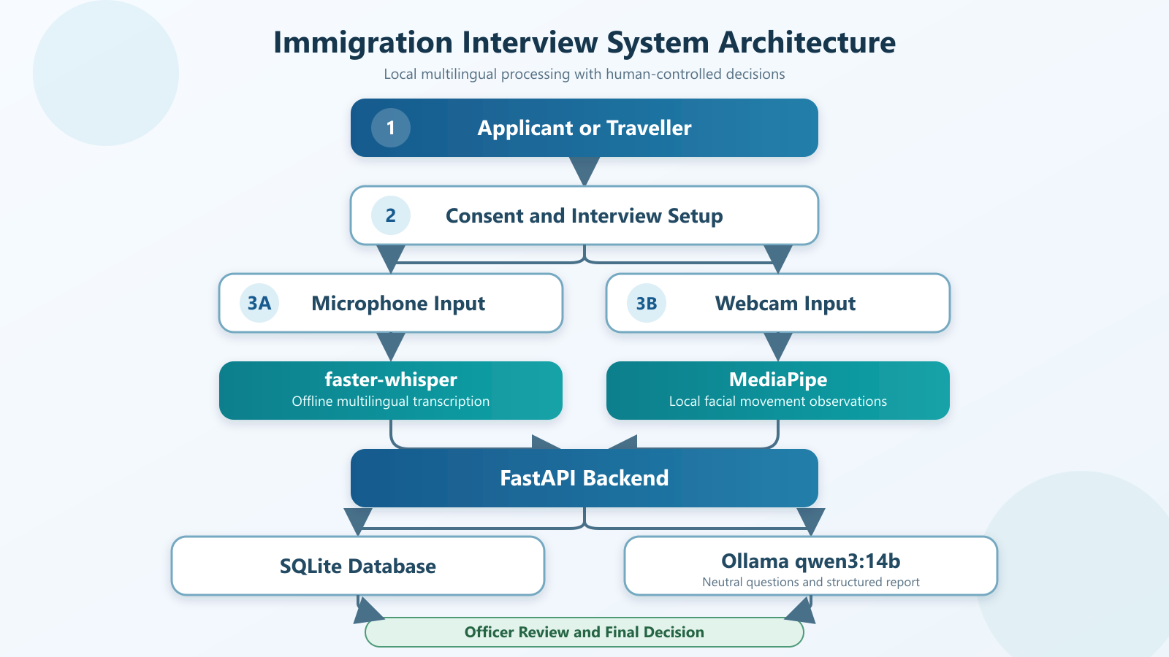
Framework/Architecture/Block Diagram

Slide 11
Functional Requirements
Select airport or visa-office interview mode
Select the applicant’s spoken language
Record consent before capture
Transcribe speech locally using faster-whisper
Allow manual transcript correction
Generate questions on things like: travel purpose, duration, accommodation, supporting documents, etc..
store transcript text locally
Generate and save the final report as a PDF
Prevent automated admissibility or visa decisions

Slide 12
Modules
Interview and consent management
Audio capture and faster-whisper transcription
MediaPipe facial-movement observation
Ollama qwen3:14b question generation
Immigration context analysis
SQLite database
Dashboard and report generation
Local PDF report saving

Slide 13
Experiments and Results
Backend automated tests: 4 passed
Frontend production build: successful
Airport interview mode: implemented
Visa-office interview mode: implemented
International language selection : implemented
Local faster-whisper integration: implemented
Ollama qwen3:14b: configured and installed
Local MediaPipe model: implemented
Offline report generation: implemented

Slide 14
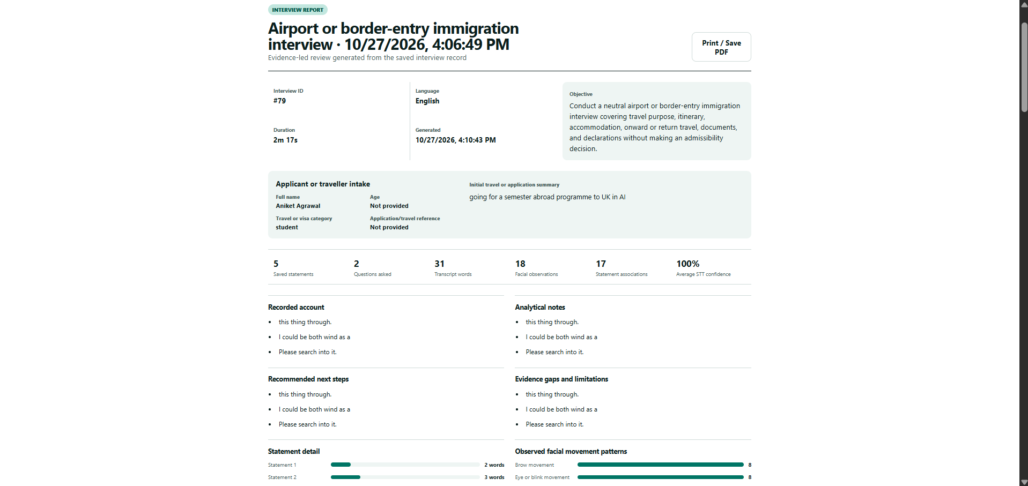
Output

Slide 15
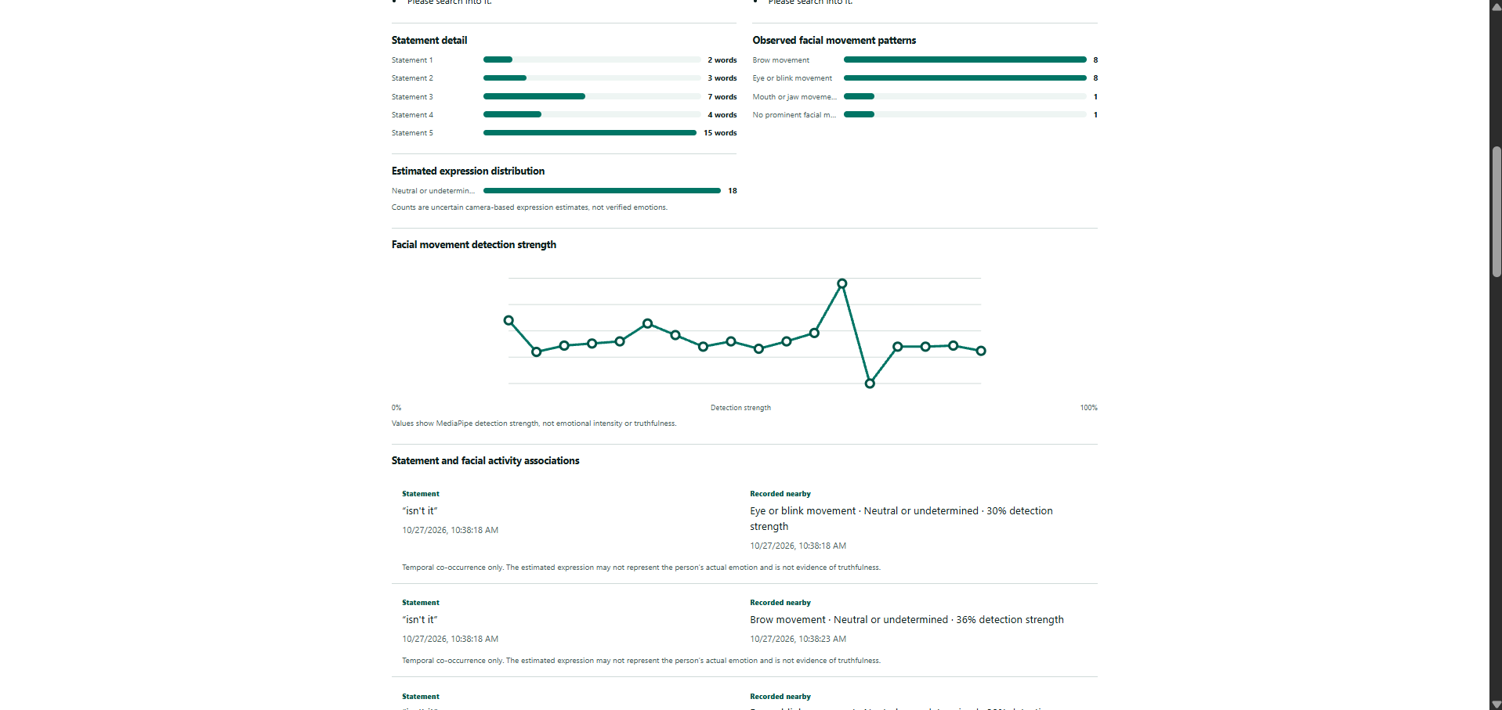
Output

Slide 16
Limitations
Transcription accuracy varies with language, accent and noise
LLM-generated question require office review
Facial observations cannot determine emotion or deception
Passport and visa document verification is not implemented
Authentication and encryption require further development
Real immigration-domain evaluation has not yet been completed

Slide 17
Conclusion and Future Work
The updated system provides multilingual interview support for airports and visa offices. It combines offline speech transcription, neutral context-aware questioning and structured report generation. The system improves interview documentation while ensuring that admissibility, visa eligibility and immigration decisions remain entirely under authorized human control.

Slide 18
Outcome Achieved
Patent – Filed/ Published/ Granted – Screen shot
(or)
International Conference Proceedings – Accepted/ Published/ Scopus Indexed
(or)
Journal Publication – Accepted/ Published/ Scopus Indexed
(or)
Start-up information (if any)
Others
Outcome Achieved Proof to be uploaded on or before 27 Oct 2026 in the given link https://forms.gle/B9B71VPy5b9bZ9dJ8

Slide 19
References
[1] Y. Mao and Y. Zhao, “Digital Gatekeepers: Exploring Large Language Model’s Role in Immigration Decisions,” arXiv preprint arXiv:2506.21574, 2025.
[2] International Civil Aviation Organization, “Traveller Identification Programme Strategy,” ICAO, Montreal, Canada. [Online]. Available: https://www.icao.int/CDI/ipack-implementing-icao-trip-strategy-roadmap
[3] International Civil Aviation Organization, “ICAO Public Key Directory: Frequently Asked Questions,” ICAO, Montreal, Canada. [Online]. Available: https://www.icao.int/icao-pkd/frequently-asked-questions
[4] International Civil Aviation Organization, “API Guidelines and PNR Reporting Standards,” ICAO, Montreal, Canada. [Online]. Available: https://www.icao.int/facilitation-programmes/api-guidelines-and-pnr-reporting-standards
[5] P. Grother, M. Ngan, and K. Hanaoka, “Face Recognition Vendor Test Part 3: Demographic Effects,” National Institute of Standards and Technology, Gaithersburg, MD, USA, NISTIR 8280, Dec. 2019.
[6] A. J. O’Toole, P. J. Phillips, X. An, and J. Dunlop, “Demographic Effects on Estimates of Automatic Face Recognition Performance,” National Institute of Standards and Technology, Gaithersburg, MD, USA, NISTIR 7757, Mar. 2011.
[7] A. Radford, J. W. Kim, T. Xu, G. Brockman, C. McLeavey, and I. Sutskever, “Robust Speech Recognition via Large-Scale Weak Supervision,” arXiv preprint arXiv:2212.04356, 2022.
[8] SYSTRAN, “faster-whisper: Faster Whisper Transcription with CTranslate2,” GitHub repository, 2026. [Online]. Available: https://github.com/SYSTRAN/faster-whisper
[9] A. Yang et al., “Qwen3 Technical Report,” arXiv preprint arXiv:2505.09388, 2025.
[10] Google AI, “MediaPipe Face Landmarker,” Google AI Edge Documentation, 2026. [Online]. Available: https://ai.google.dev/edge/mediapipe/solutions/vision/face_landmarker

